Slide 1

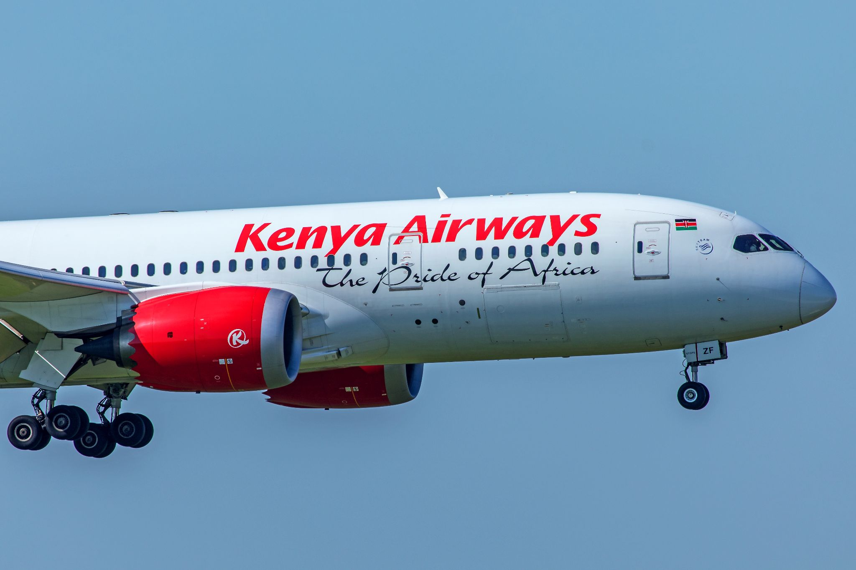

Customer Feedback Analysis

Slide 2
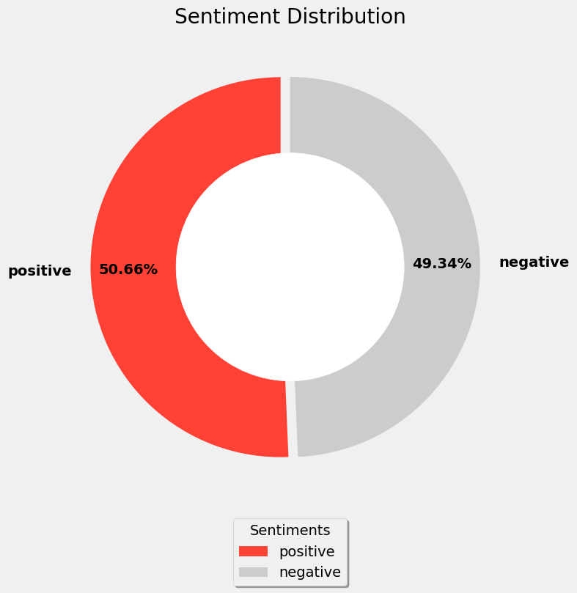
Sentiment Scores
The sentiment distribution reveals that 50.66% of customers expressed a positive sentiment in their reviews, while 49.34% expressed a negative sentiment. This indicates that the customers had equally as many positive sentiments as negative ones.

Slide 3
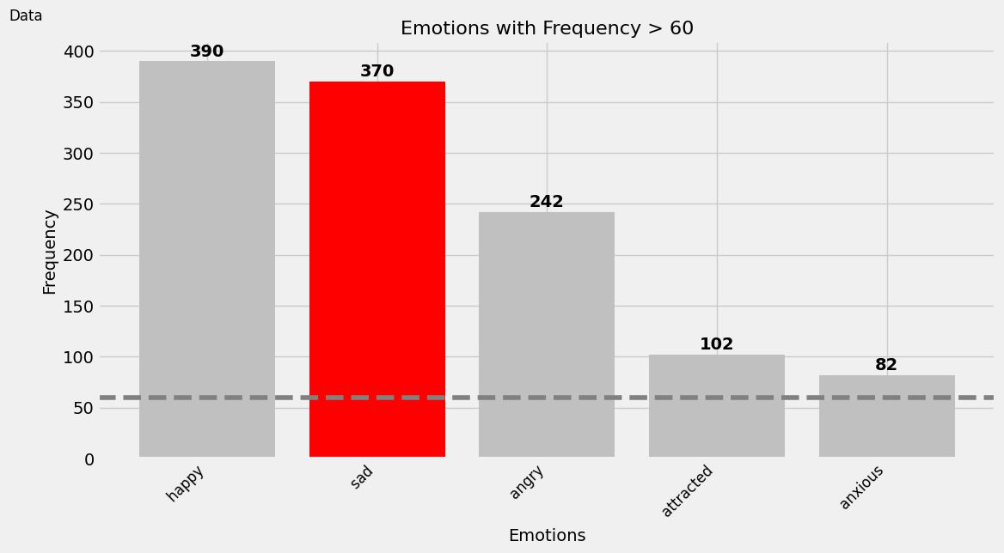
Frequency Emotions
Among the frequent emotions, "happy" was expressed by 390 people, while "sad" was expressed by 370 people.

Slide 4
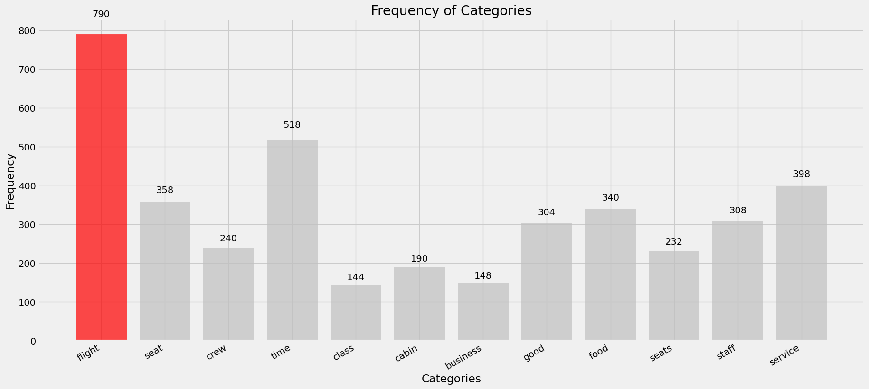
Frequency Categories
Among the frequent categories, "flight" was ranked first with 790 mentions.

Slide 5
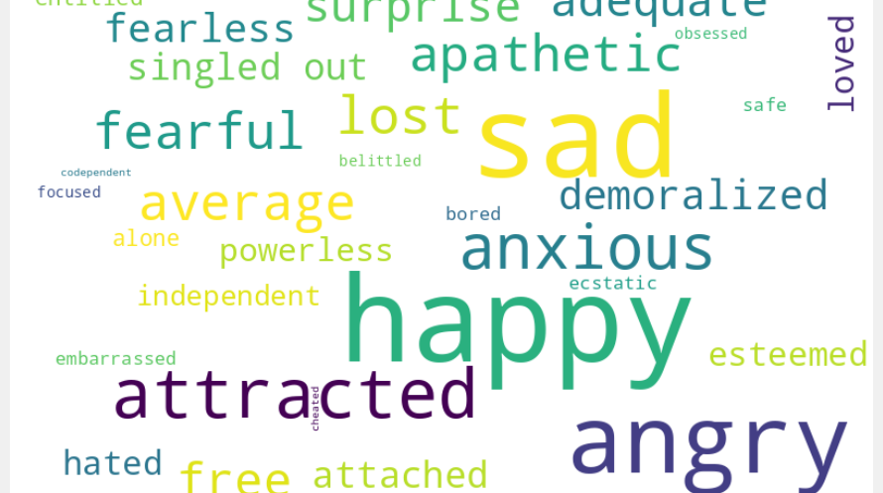

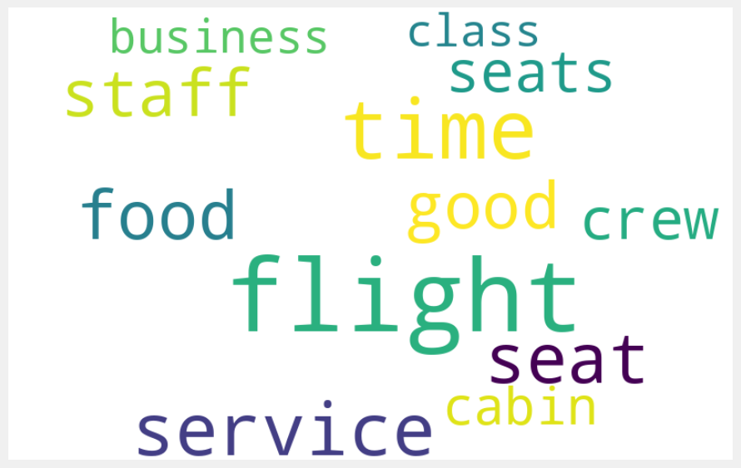
Word Cloud
Word Cloud for Emotions
Word Cloud for Categories

Slide 6
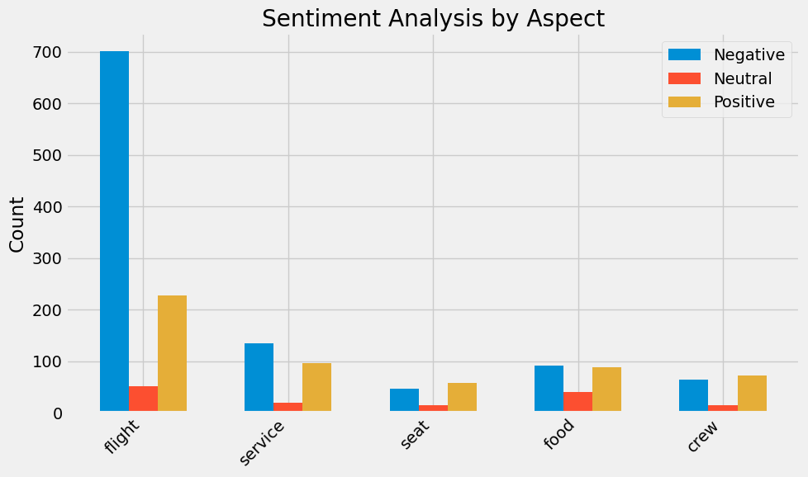
The graph depicts sentiment analysis results based on aspect categories using a pre-trained BERT model. The script begins by loading libraries and models for aspect extraction and sentiment analysis. It defines aspect categories such as flight, service, seat, food, and crew. Aspect extraction from the provided text is done using spaCy, and then sentiment analysis is performed for each aspect using the BERT model. The script accounts for negations in the text to adjust sentiment analysis appropriately. The results are printed, showing sentiment counts for each aspect category. For instance, in the 'flight' aspect, there are 701 negative, 52 neutral, and 227 positive sentiments. Similarly, sentiments are counted for 'seat', 'crew', 'food', and 'service' aspects, providing insights into the sentiment distribution across different aspects of the reviews.

Slide 7
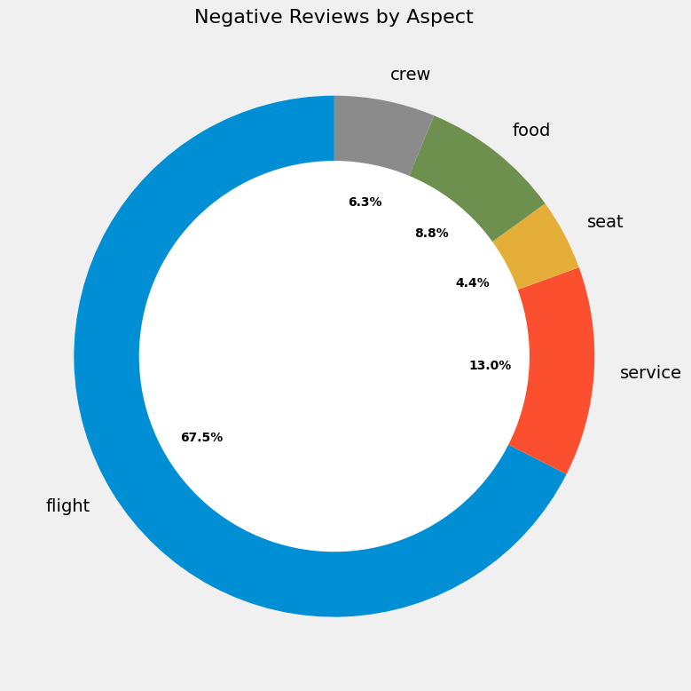
This chart shows the distribution of negative reviews and where the bulk of them come from.

Slide 8
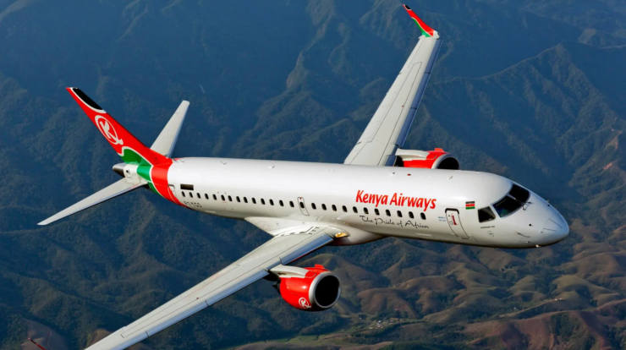
Thank you!

